Slide 1
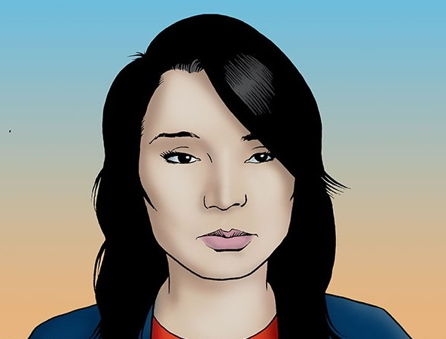
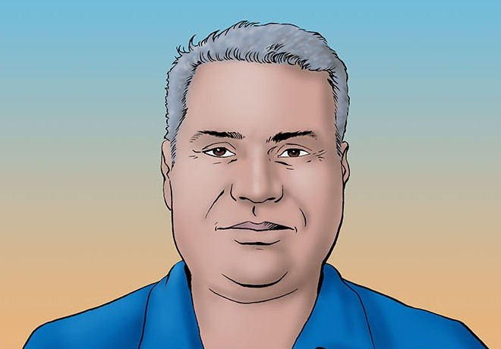
Activity 1
New KDIGO IgAN Clinical Practice Guidelines: Improving Patient Lives and Outcomes

Slide 2


Information and Guidelines
These slides may be used in your noncommercial presentations.
When using these slides, please retain the source attribution:
For more information about the slides, please contact info@cmeology.org
Disclaimer: The information presented is not meant to serve as a guideline for patient management. Any procedures, medications, or other courses of diagnosis or treatment discussed or suggested should not be used by clinicians without evaluation of their patient’s conditions and possible contraindications and/or dangers in use, review of any applicable manufacturer’s product information, and comparison with recommendations of other authorities.
Side credit: CMEology and Medical Education Resources

Slide 3
Case 1. Meet Sophie
Sophie is a 31-year-old insurance executive, married with two children; no plans for additional children
She had unexplained hematuria (2+) and proteinuria (1+) identified on an annual exam
Her blood pressure is 145/82 mm Hg
Her creatinine clearance is 1.2 mg/dL, with an eGFR of 62 mL/min/1.73m² and urinary protein of 0.8 g/24 hours
She recently underwent a kidney biopsy as part of a diagnostic work-up, with the following results:
  MEST-C: M1, E0, S1, T0, C0
  IIgAN-PT—risk of 50% decline in eGFR or progression to ESKD within 5 years of biopsy is ~12.95%
Dr. Patel, her nephrologist, has just told her she has IgAN
Notes:
Barratt

Slide 4
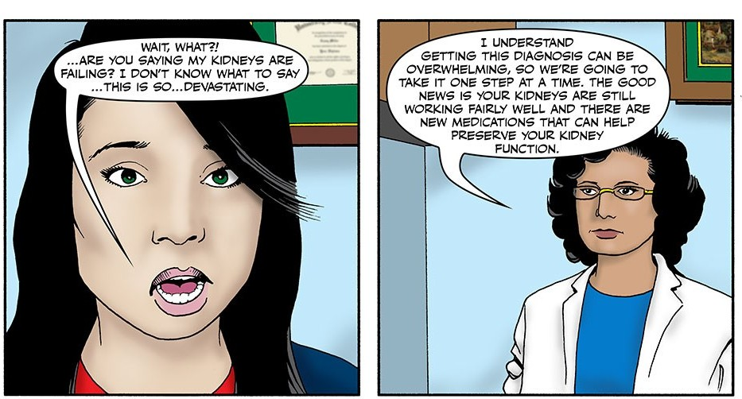

Slide 5
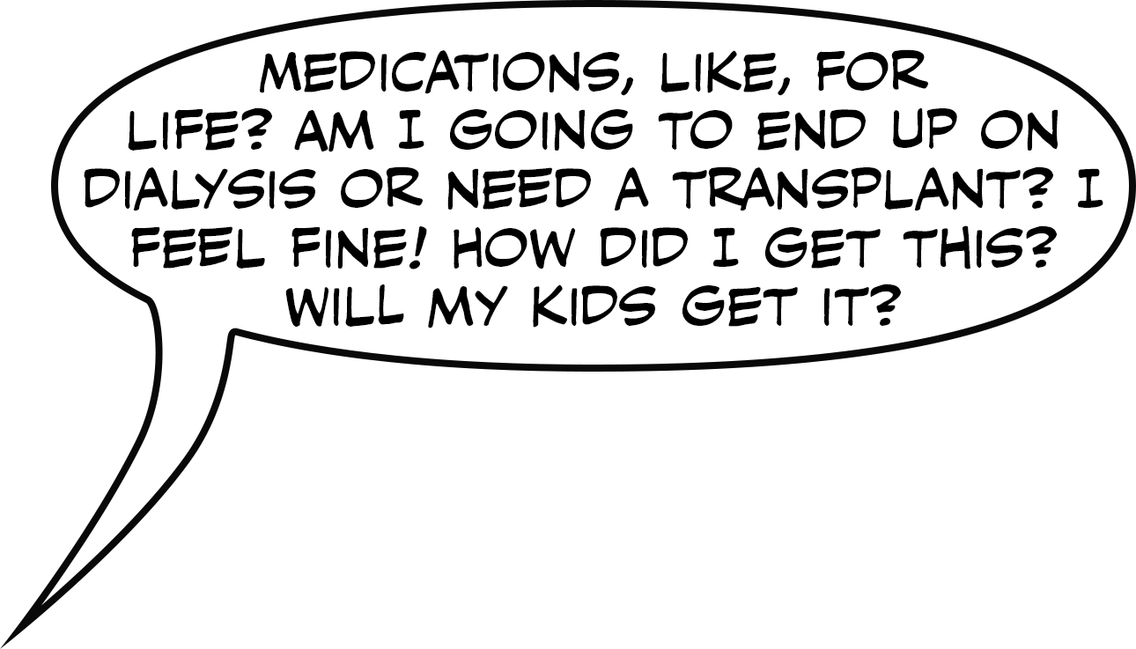
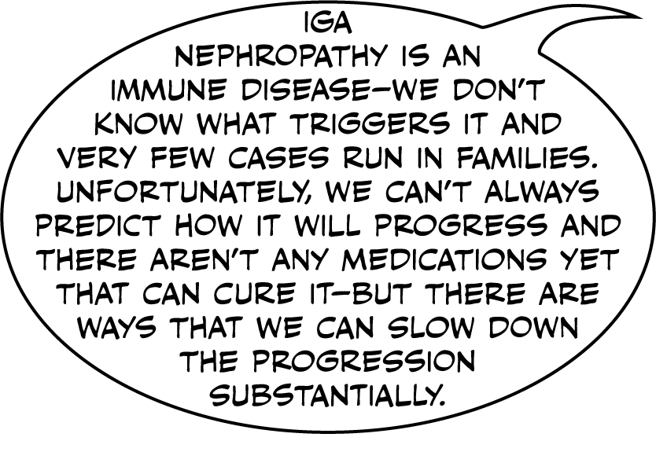

Slide 6
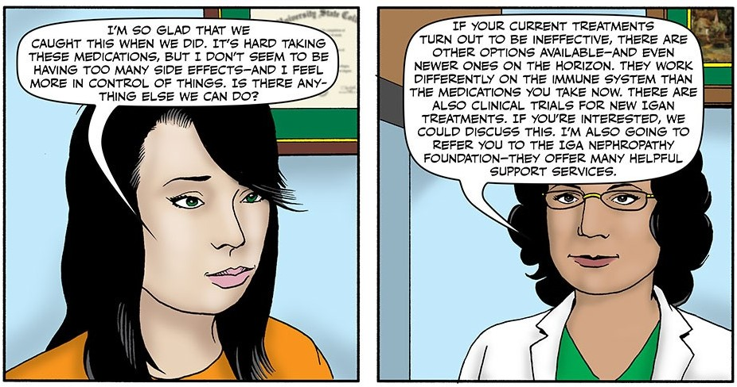

Slide 7
Case 2. Meet Nolan
Nolan, a 47-year-old store manager, was diagnosed with IgAN at age 38
Changes in his lab results from 9 years ago are as follows:
Current medications: ramipril 20 mg/day, empagliflozin 10 mg/day, lansoprazole 15 mg, atorvastatin 20 mg
Blood pressure 156/90 mm Hg; BMI 28 kg/m²
Physical exam: normal, except for 1+ ankle edema
Other lab results: glucose (fasting) 110 mg/dL, A1C 6.1%
  Total cholesterol 239 mg/dL; triglycerides 130 mg/dL,
  HDL 45 mg/dL; LDL direct 158 mg/dL
Lab Test | At Initial Dx | Now
Serum creatinine | 1.0 mg/dL | 1.8 mg/dL
eGFR | 60 mL/min/1.73 m² | 42 mL/min/1.73 m²
24-hour urine protein | 1.2 g | 2.0 g
Notes:
Rizk
[[Changed Urine protein Now column]]

Slide 8
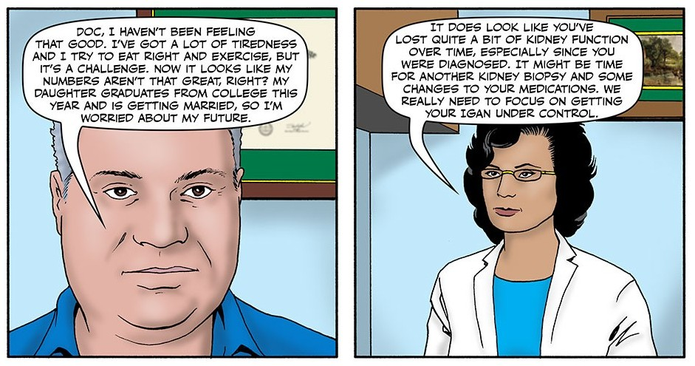

Slide 9
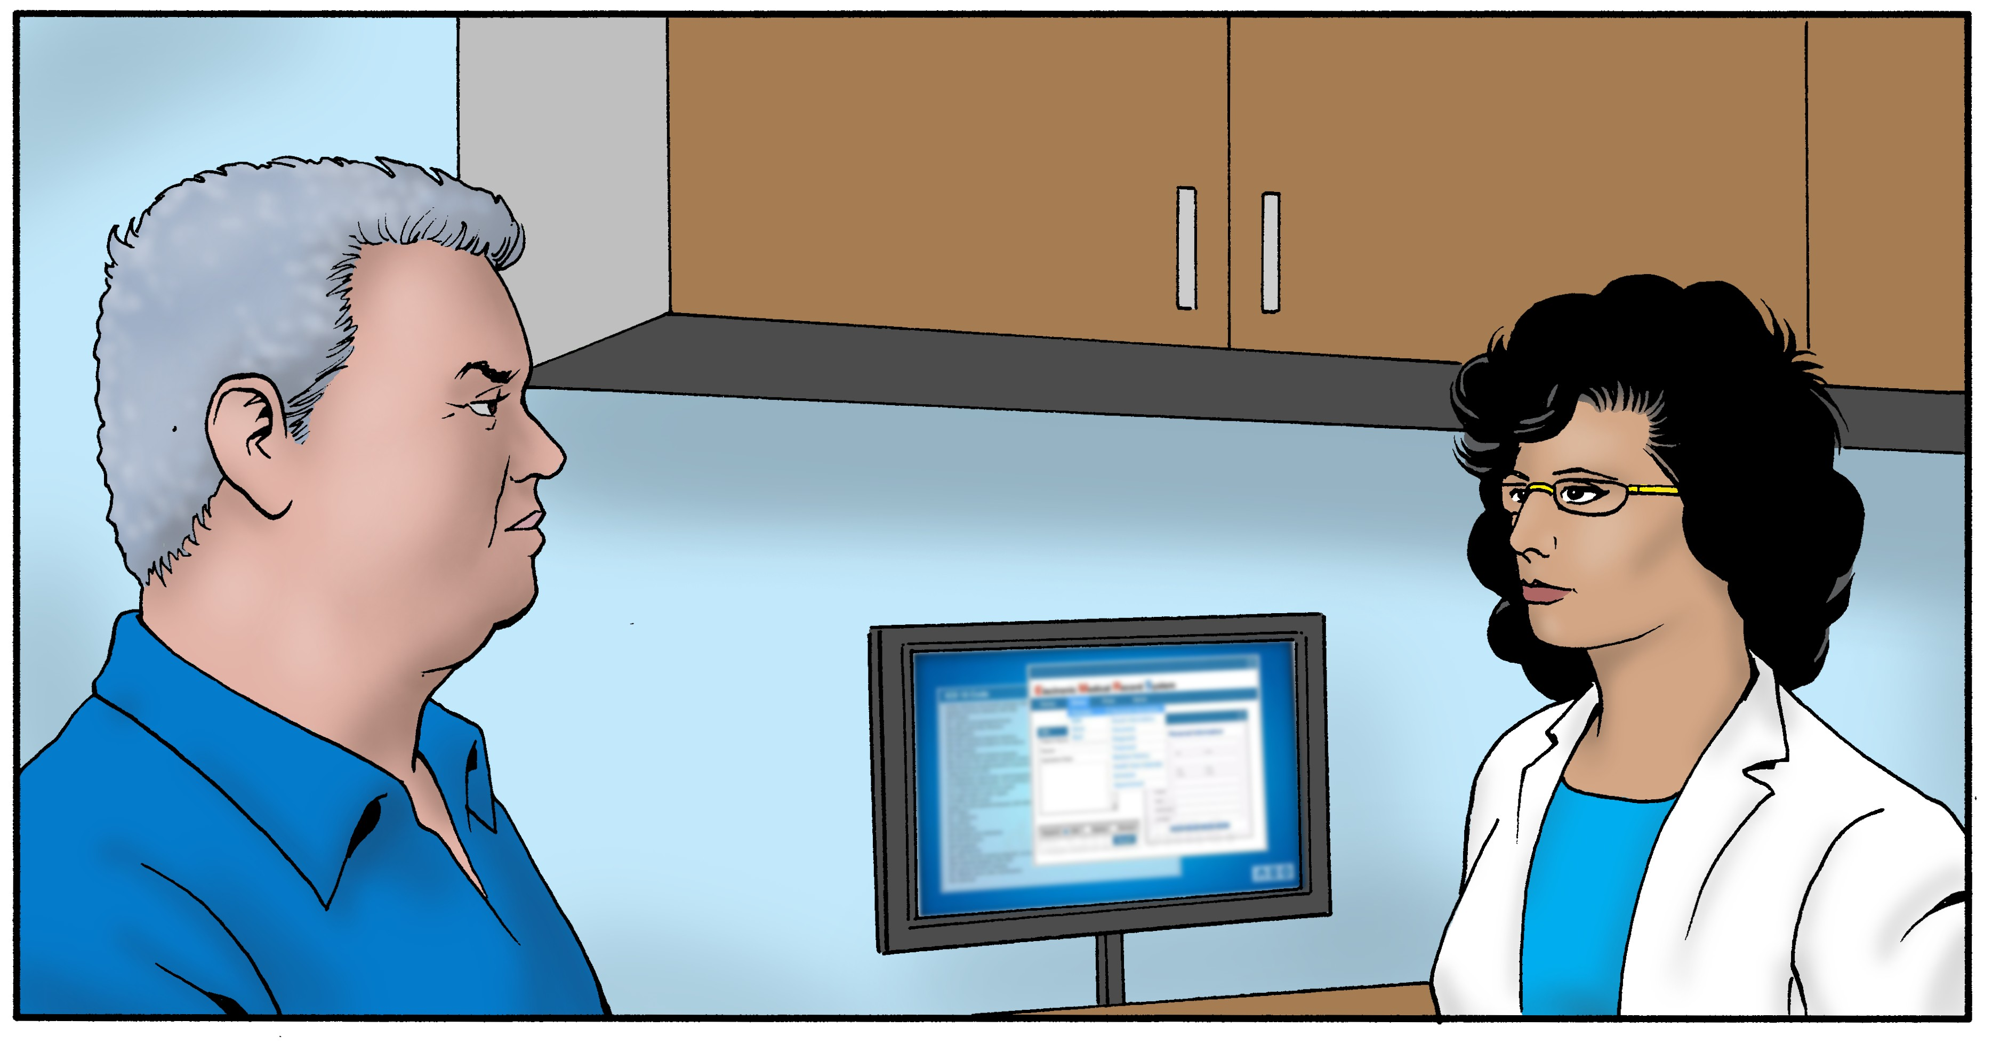
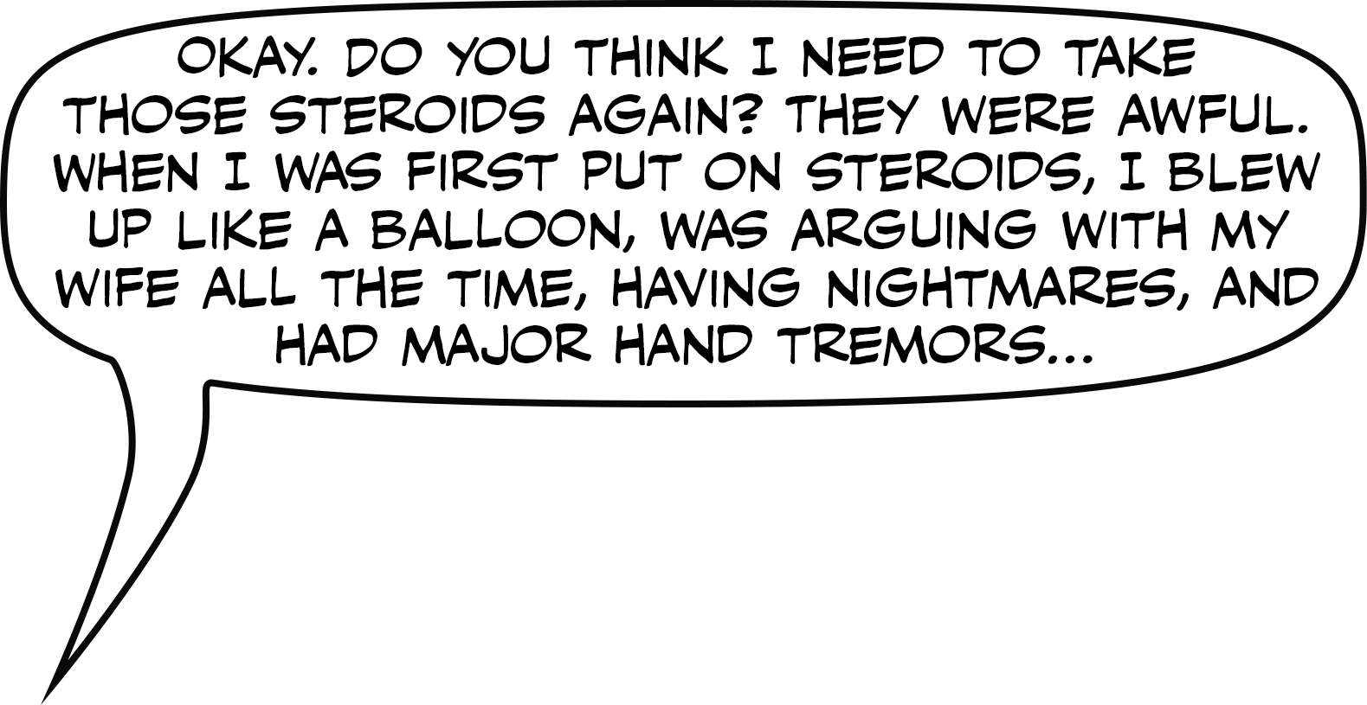
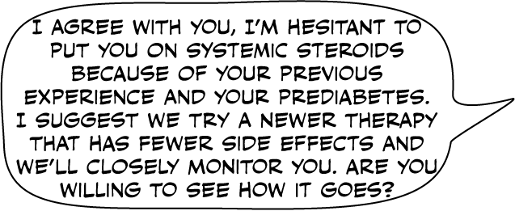

Slide 10
